Slide 1
An introduction to Neighbourhood Planning
Andrew Towlerton MRTPI
Notes:
Explain who I am and yourlocale

Slide 2

Aims of Today’s Session
What is Neighbourhood Planning?
What is involved?
Is it the right option?
What help is available?
Lessons Learnt?
Interactive as possible

Slide 3
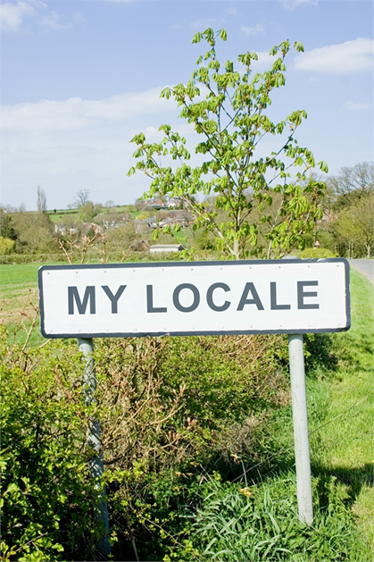
Yourlocale
Yourlocale – set up to support delivery of community rights
Gary Kirk – Former CEO of Meden Valley Making Places; Neighbourhood Planning Examiner; Parish Councillor
Andrew Towlerton – Planner; former Head of Planning; National Advisor to SLCC; Parish Clerk
Currently supporting 22 Parish Councils across the Midlands and Yorkshire

Slide 4
Origins
Part of Localism Agenda
Government’s desire to transfer power and responsibilities
But also…
Simplification of system – planning seen as being remote and complex

Slide 5
Origins
“Planning has tended to exclude, rather than to include, people and communities
Planning policy itself has become so elaborate and forbidding – the preserve of specialists, rather than people in communities
We are allowing people and communities back into planning”
Rt Hon Greg Clark MP
National Planning Policy Framework (2012)

Slide 6
Origins - More
But also desire for parish councils to be more involved in the Planning System
“Being involved in town and country (land use or spatial) planning is, for many Councils, their single most important activity”. (The Good Councillor’s Guide – The National Training Strategy for Town & Parish Councils, 3rd edition)
Also limitations with ‘Parish Plan system

Slide 7
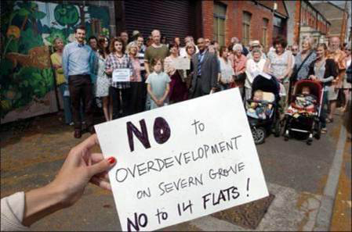
The end of…….?
Notes:
7

Slide 8
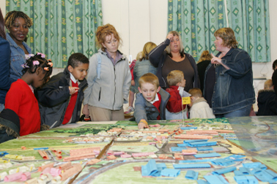
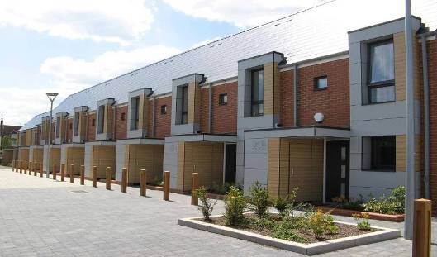
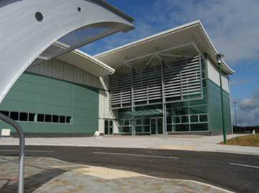
And more of this
Notes:
8

Slide 9
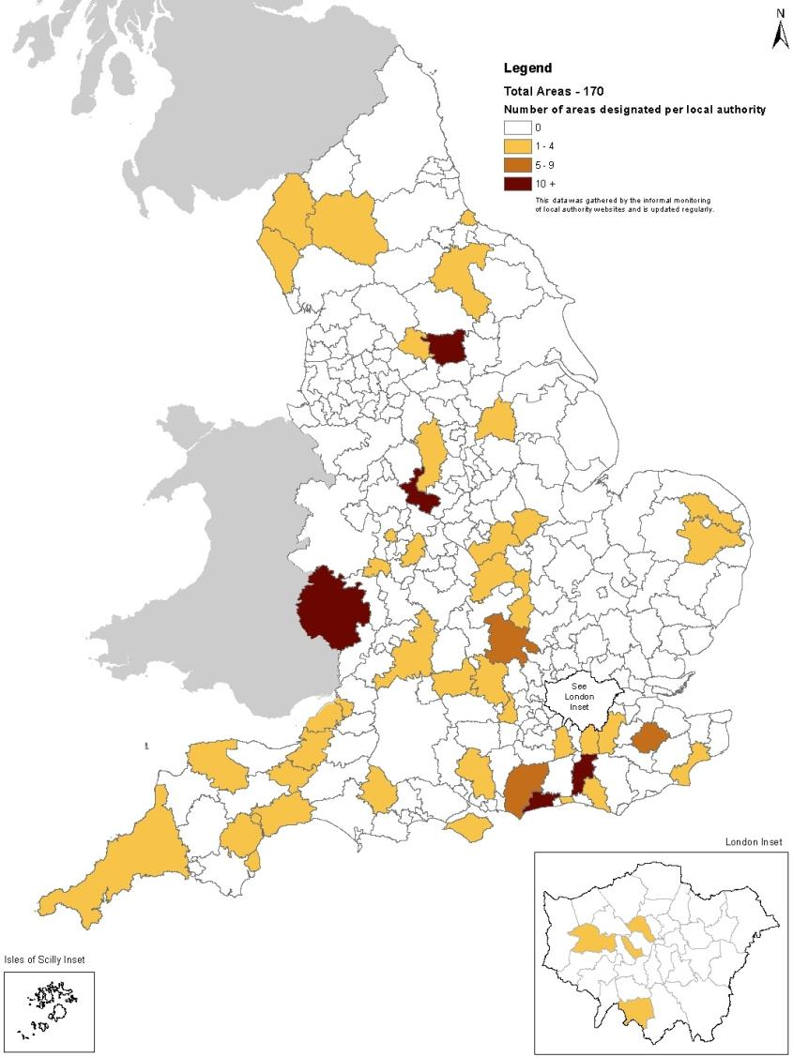
A Growing Movement
January 2013

Slide 10
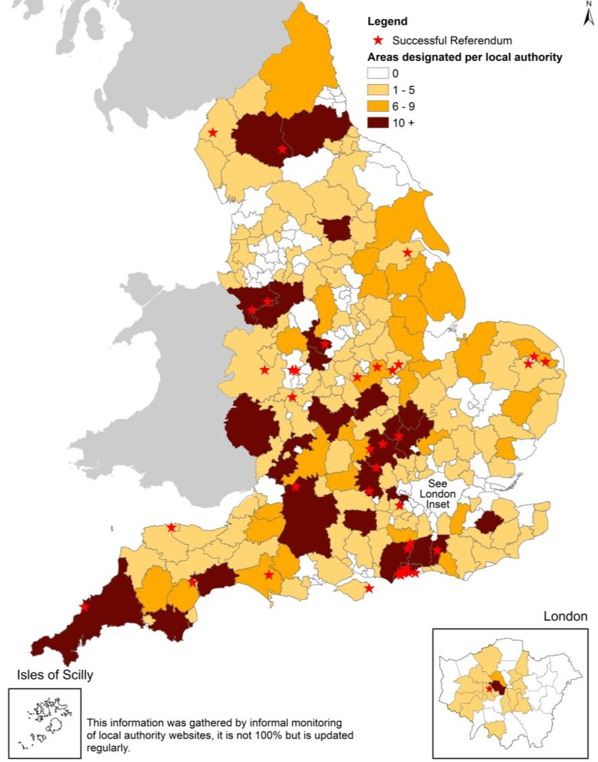
A growing movement
April 2015
1,300+ areas designated
70 passed examination
44 passed referendum
36 made into law

Slide 11
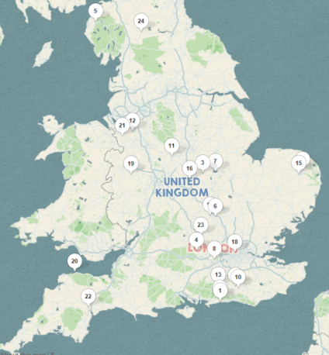
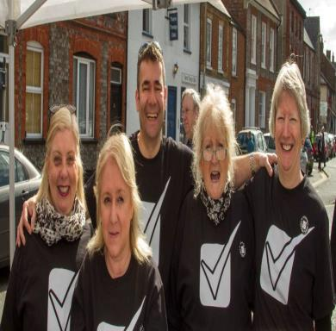

Applications 1380
Designations 1213
Pre- submission 212
Average
‘Yes’ vote
87%
Turnout 33%
Examination 124
Total:
124
74
52
38
At Examination
Passed Referendum
Neighbourhood plans
Passed Examination
MADE
(At each stage)
(42)
(26)
(7)
(38)
Neighbourhood Planning
From the Ground Up
62%
of Local Authorities contain designated neighbourhood planning areas
Local Authorities
There are 336 local planning authorities
(not including county councils)

Slide 12
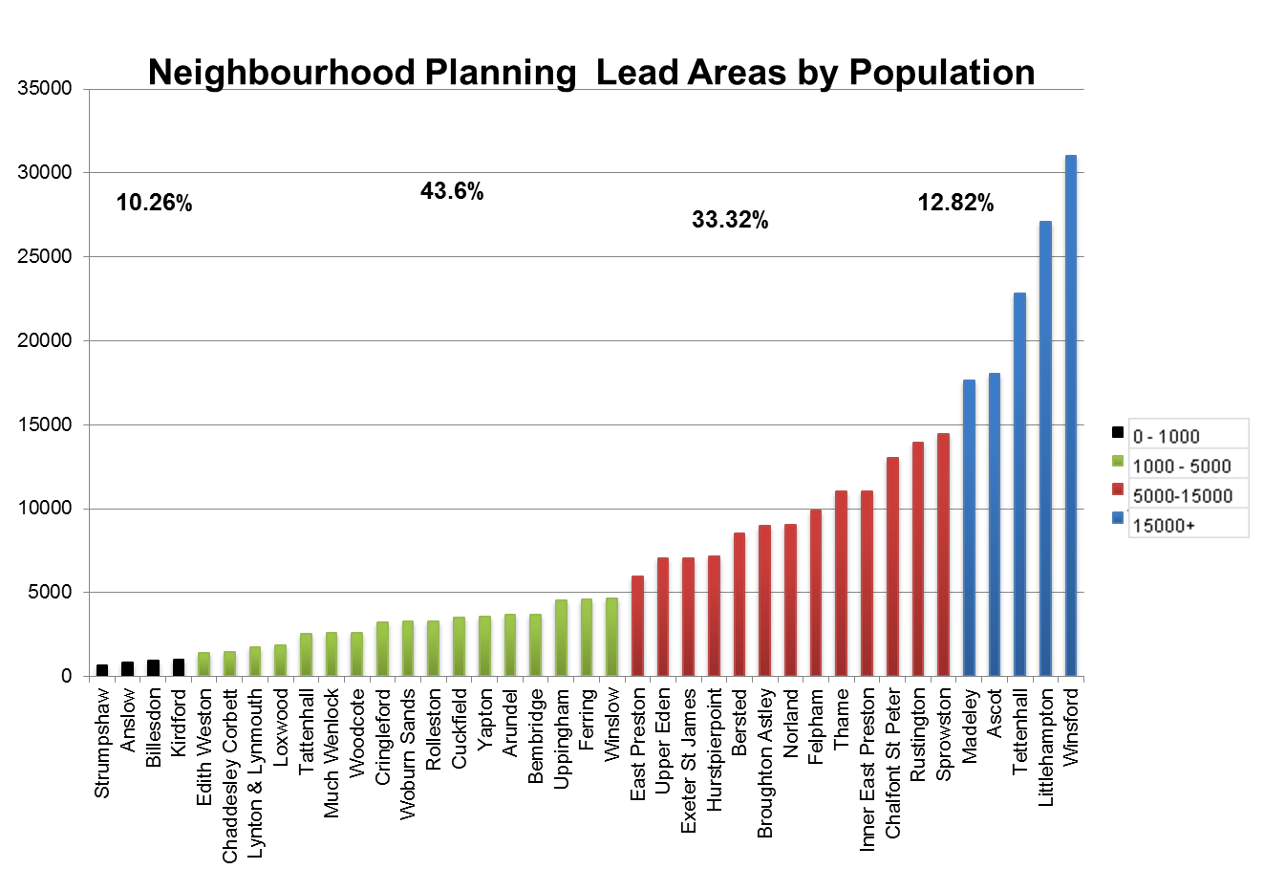
All shapes and sizes
Notes:
Communities range from small villages to market towns of over 15000 population.
Single issue plans to complex plans with site allocations for housing.
Some businesses areas. Eg Southbank, Central Milton Keynes.

Slide 13
Neighbourhood Plans are Flexible
SIZE
  There is no typical NP community. Strumpshaw has a population of 650, whilst Winsford’s is over 30,000.
SCALE
  Plans can be as small or expansive as you like. Tattenhall has just 6 policies, whilst Thame has 64. Similarly, policies can be very simple or more detailed and can allocate sites if you wish.
COST
  Plans vary in cost depending on scale and skills required

Slide 14
Will they make a Difference ?
“Pickles overrules planning inspector to block 111-home development
Eric Pickles has overruled his own planning inspector to block a 111-home development in Leicestershire because it conflicts with an adopted neighbourhood plan”.
Inside Housing 25 April 2014

Slide 15
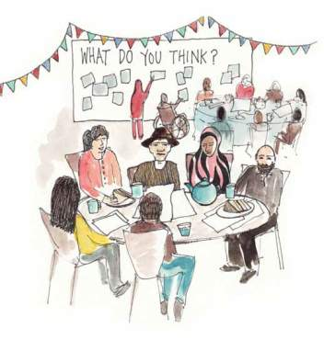
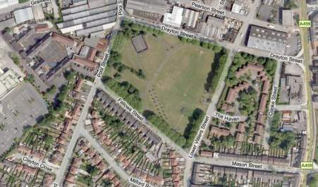
Neighbourhood Planning
What is a Neighbourhood Plan?
It is about a community using land use and development to deliver somewhere too:
work
shop
live
travel
park
play
eat
drink

Slide 16
A Plan Led System
The primacy of the development plans established by S54 A of the 1990 Act
Decisions should be taken in accordance with the plan, unless material considerations indicate otherwise
Broadly Hierarchical (see next slide)

Slide 17
POLICY CONTEXT
National Planning Policy Framework (NPPF)
Duty to co-operate
Sub-regional plans?
Local Plan (core strategy and other documents)
Neighbourhood Development Plans and orders
Local community plan (non statutory)
presumption in favour
of sustainable development
Notes:
Some fundamentals remain – we still have a plan led system and the benefit of having strategic policies to underpin the choices made is acknowledged. The existing tools – Area Action Plans etc remain and will still be the appropriate tool to use for some places.
We will begin at the top with the NPPF and the presumption in favour of sustainable development. We still have the ‘conformity’ chain – that local plans (core strategies) need to be in accordance with the NPPF, and neighbourhood plans need to be in line with the strategic objectives of the local plan.
This is one reason why it’s so important to get your local plan in place – to give the framework to neighbourhood plans, and make sure the position on strategic issues is clear.

Slide 18
How is the Neighbourhood Plan prepared ?
Process instigated by parish council or Neighbourhood Forum
Local Authority Support
Local Authorities must provide support and advice to parishes or forums preparing a plan.
Plan prepared by local communities with council providing support and advice
Extensive community engagement
Legal Compliance & Conformity
Must be in general conformity with national and local e.g. district/city policy
Neighbourhood plans must comply with a number of EU Directives (e.g. Environmental Impact Assessment, Habitats Directive)
Examined by independent examiner considering fit with local development plan, national policy and alignment with other neighbouring plans – leading to non-binding report
Proceed to referendum
Referendum seeking adoption. Simple majority in favour to progress to adoption - should we agree this neighbourhood plan?
Referendum
Referendum area can be wider than neighbourhood – if proposals impact on others
Neighbourhood Plan Adopted by local authority
Notes:
18
This slide is borrowed from a DCLG presentation but is a useful representation of how a neighbourhood plan gets statutory status. The only bit that’s missing is earlier in the process – when the authority has to recognise the Forum as an appropriate one for neighbourhood plan making.
The examination is ‘light touch’, probably by written reps. It looks at fit with national policies and strategy, the EU bits, and fit with other neighbourhood plans.
The referendum is a simple majority – the question is ‘should we agree this neighbourhood plan?’

Slide 19
Examples of emerging policies
Environment | Economy
Neighbourhood design guide & place specific design policies | Protection & allocation of employment
Designation of Local Green Space | Protection of car parks
Coalescence of settlements | Town centre redevelopment sites
Protection of gardens | Development of workshops
Small scale renewable energy | Encouragement of working from home
Enhancement of biodiversity | New retail in town centres
Control of advertisements & protection of traditional shop fronts | Protection of business uses in village centre

Slide 20
Examples of emerging policies
Housing | Community Facilities
Residential uses in town centres | Allotments
Code for Sustainable Homes | Cycle & pedestrian links
Car parking spaces in development | Protection of local shops and pubs
Meeting local housing need & occupation of affordable housing | Developer contributions to improvement of community facilities
Housing for local older people | New community facilities
Conversion of redundant buildings | Development of community hubs
Housing on farms | Protection of community facilities
Limit extensions on small properties | Broadband provision

Slide 21
Why communities might want one
Statutory Plan
Enables local communities to decide how their area will develop
More detailed policy than might exist in the Local Plan
Will strongly influence future planning decisions in that area
Feet round the planning table
Shared Vision for the Community
Bring communities together
Notes:
21

Slide 22
And might not want one
Not certain i.e. can be rejected at referendum
Still only one of a number of ‘material considerations’
Cannot be used to stop development
Where an area is not facing development pressures may be of limited value
Other options – Village Design Statements
Can be resource intensive

Slide 23
We spent…
In the small coastal village of Lympstone: £6,389
In the large Leicestershire village of Broughton Astley: £14,312
In the Exeter ward of St James: £10,450
In the deprived urban area of Heathfield Park: £19,500
In the coastal towns of Lynton & Lynmouth in Exmoor: £27,681
In the small Norfolk village of Strumpshaw: £4,220
But does not include all costs e.g. clerk/cllr time etc.
Average: £13,758
Notes:
Population of the neighbourhood area (from 2011 Census data):
Strumpshaw: 634
Lympstone: 2,046
Exeter St. James: 6,891
Woodcote: 2,604
Broughton Astley: 11,140
Heathfield Park: 8,883

Slide 24
Sample of spend – Broughton Astley
    £5,000 Project planning advice & Graphic design
    £3,820 Rural community Council (consultation events, design/analysis of survey)
    £3,035 Printing & distribution
    £360 Advertising in newspapers
    £210 Environmental data from Leicestershire Council
    £130 Postage
    TOTAL SPEND: £14,312

Slide 25

Resources Available
Neighbourhood Planning Support Programme
31 October Ministers announced:
£22.5 million support package over 2015 to 2018
£12 million funding for 2015/16 for local authority new burdens
Also Awards For All

Slide 26
Neighbourhood Planning
Other Neighbourhood Plans
Neighbourhood Development Orders
grant planning permission for certain kinds of development within specified area
Community Right to Build Orders
grant planning permission for development schemes

Slide 27
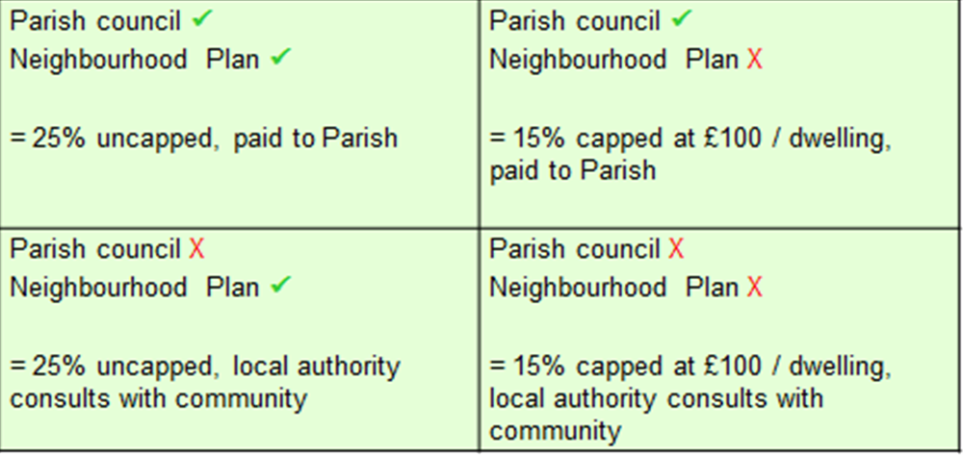
CIL and Parish councils

Slide 28
Summary
Better understanding of NP process?
Better understanding of the role of local councils in this ?
Outstanding points?

