Slide 1
Earswick Neighbourhood Plan Residents Survey No 2
Draft Vision and Objectives
Key Findings
June 2016

Slide 2
Introduction
The Draft Neighbourhood Plan will state that:
There will be no building on the green belt
There will be no change to the existing green belt boundary
Green spaces will be protected
Areas of conservation/wildlife value will be protected
Sports, Amenity and Leisure areas will be protected

Slide 3
Introduction
If development is forced upon the village then the Neighbourhood Plan should provide an insurance policy by stating that:
Brownfield sites must be developed first
Any increase in the number of houses must not exceed 10% over the next 20 years

Slide 4
Background
Builds on findings from first questionnaire
Essentially Earswick is a great place to live and you wish to sustain and enhance this
Key issues
Development (e.g. limiting development esp. new housing, retain village size/characteristics)
Protect green belt and open spaces
Security – open spaces and community safety
Also other issues
Other housing issues (e.g. good quality)
Road safety and traffic issues e.g. pedestrian, cycling, roads and public transport
Good maintenance (public areas, homes, etc.)

Slide 5
Background
A working party has led translating the findings of the questionnaire into key objectives/plans
These will then form the basis of the Plan
The questionnaire sought residents views on these emerging objectives/plans
61% (206) response rate very good
The findings of which are set out below

Slide 6
Draft Objectives
Our Neighbourhood Plan aims to maintain and improve our distinctive ‘small, green, safe and friendly village’ while accommodating some modest development to support City of York Council’s growth ambitions over the next 15 years. In order of importance of issues identified by you, our plan objectives are to:
Ensure that the village continues to be a safe and secure place in which to live;
Protect our open space and the landscape;
Seek ongoing improvements to public transport facilities, road and pathway conditions;
Deliver modest housing development that is sensitive to the environment, infrastructure constraints and improves the quality of life for all current and future residents;
Maintain and improve local facilities for all residents.

Slide 7
Objective 1: Ensure that the village continues to be a safe and secure village to live in
Construct the proposed security fencing around the open space areas and to continually monitor the security of these areas.
Consider improved security measures around the village hall to combat antisocial behaviour.
Continue to support and encourage residents to take part in the Neighbourhood Watch Scheme.
Continue to have regular dialogue with representatives of North Yorkshire Police with regard to the provision of security and to combat crime.
Ensure that any new developments implement appropriate security measures.
Work with other stakeholders to discourage unwanted cold-calling.

Slide 8
Objective 1 - What’s important to you?
Ensure that the village continues to be a safe and secure to live in - % of those responding agreeing or strongly agreeing; ranked
Regular dialogue with NY Police (97%)
Construct security fencing around open areas (60%)
Work with stakeholders to discourage cold callers (96%)
Support Neighbourhood Watch Scheme (92%)
Any new developments to include appropriate security measures (87%)
Improved security measures around village hall (72%)

Slide 9
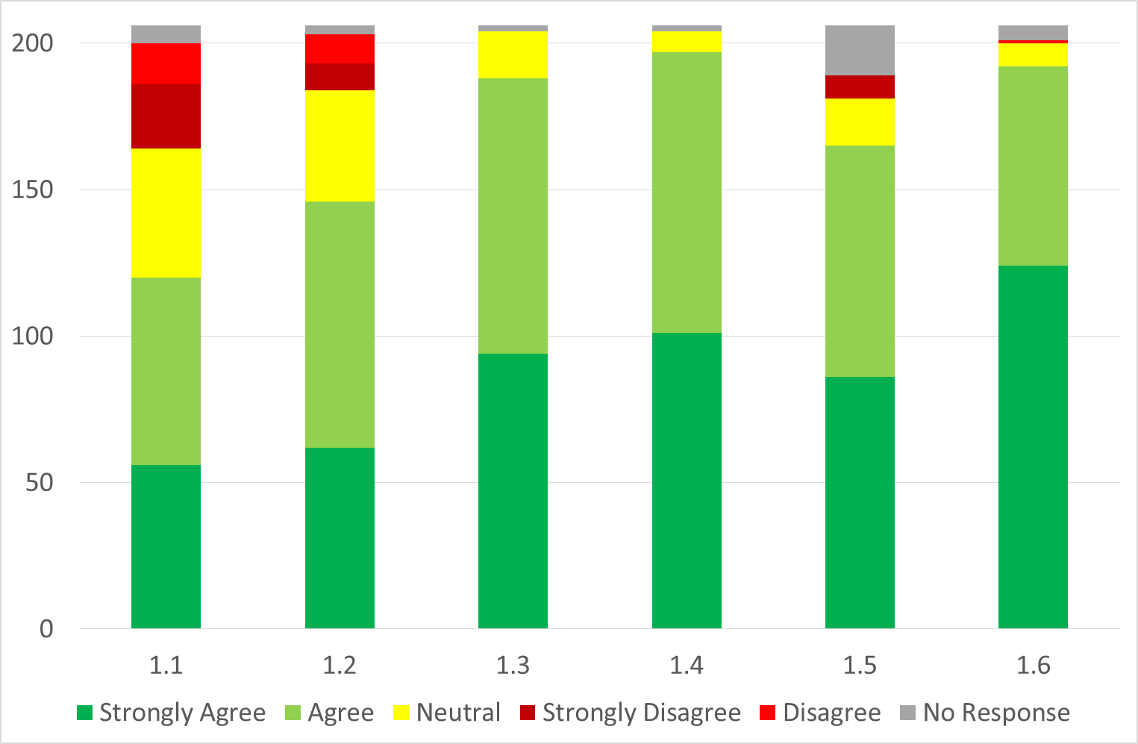
Objective 1: Ensure that the village continues to be a safe and secure village to live in

Slide 10
Objective 2: Protect our open space and the landscape.
Protect the unique rural character of our village.
Enhance and maintain the existing acreage of public open space.
Protect as much of the existing Green Belt.
Protect and where possible restore, create and manage existing and potential wildlife sites and habitats within the village.
Protect our existing natural distinctive landscape.
Ensure that all development proposals do not have an adverse impact on existing wildlife sites or habitats.
Ensure that all applications for development should demonstrate within their Design and Access Statements how the need to minimise any negative visual or landscape impact will be addressed in the scheme design.
continued….

Slide 11
Objective 2: Protect our open space and the landscape (continued)
Ensure that any new housing and development proposals within the Village include an environmental assessment of their potential impact on woodlands, hedgerows, ponds, streams, verges/ditches and any other geological features as well as existing open views and vistas.
Encourage the use in developments of soft landscaping to match and where possible enhance the existing natural environment.
Ensure any applications to fell significant trees must be supported by appropriate evidence.
Develop a strategy with other stakeholders on how to minimise/eradicate the fouling of our footpaths and open spaces by dogs.

Slide 12
Objective 2 - What’s important to you?
Protect our open space and the landscape - % of those responding agreeing or strongly agreeing - ranked
Develop a strategy to minimise/eradicate dog fouling on footpaths and open spaces (96%)
Protect and wherever possible enhance wildlife sites (95%)
Protect our landscape (94%)
Enhance and maintain open space (95%)
Ensure that all minimise there visual impact (93%)
Ensure that any development includes an environmental assessment of their impact on woodlands, hedgerows, views etc. (91%)

Slide 13
Objective 2 - What’s important to you? - cont
Protect our open space and the landscape - % of those responding agreeing or strongly agreeing – ranked
Ensure any application to fell significant trees is supported by evidence (91%)
Encourage in development the use of soft landscaping (90%)
Protect as much of the Green Belt (90%)
Ensure that development do not have an impact on habitats and wildlife sites (90%)
Protect the unique character of our village (91%)

Slide 14
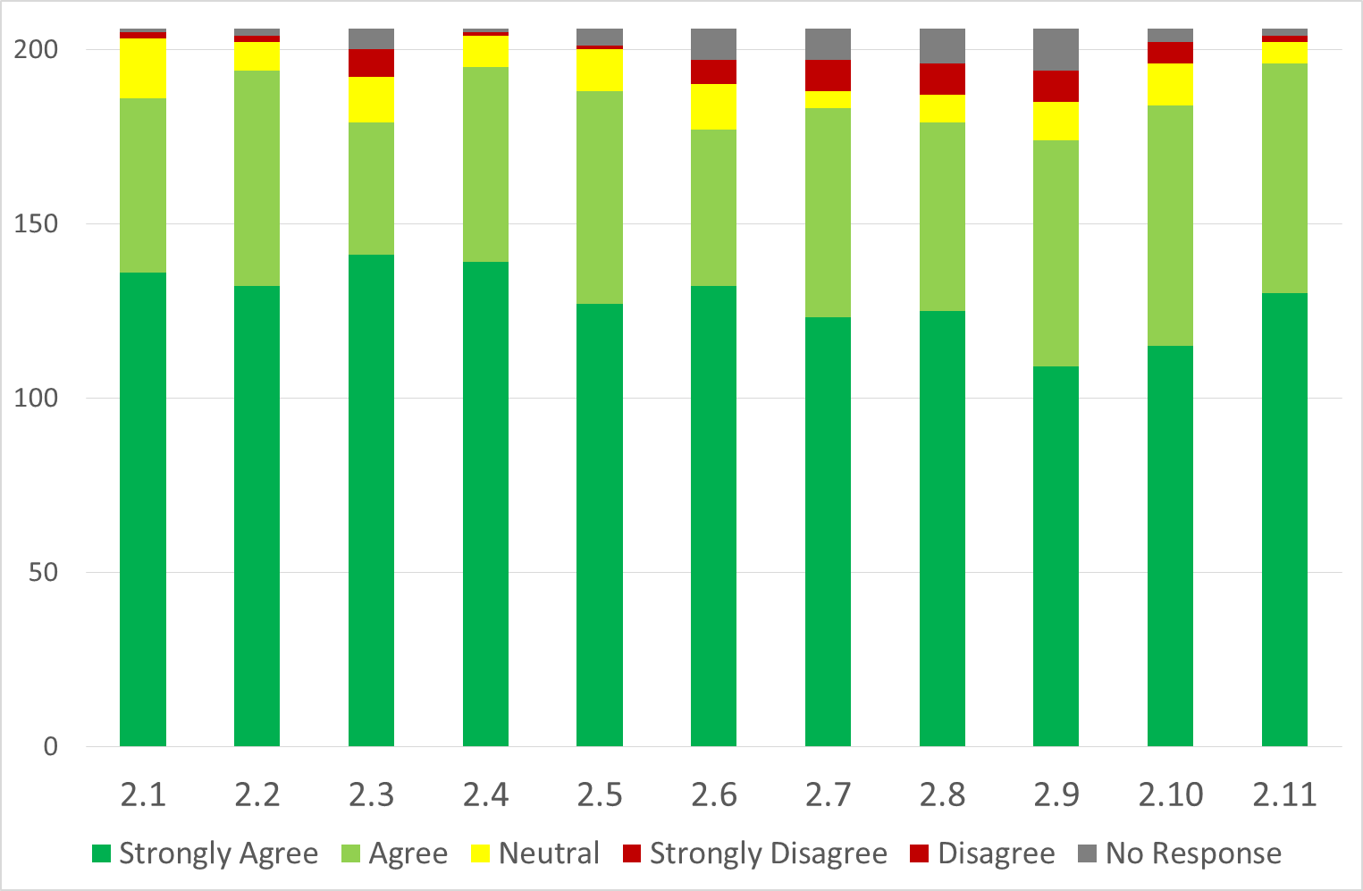
Objective 2: Protect our open space and the landscape

Slide 15
Objective 3: Seek ongoing improvements to transport facilities, road and pathway conditions.
Carry out a thorough review of all traffic issues within the village.
Engage with the Highways Department to discuss safer routes for pedestrians and cyclists crossing the ring road as part of the reconfiguration of the roundabout on the A1237.
Investigate ways to improve public transport by engaging with relevant stakeholders.
Explore with City of York Council the possibility of providing a cycle lane through the village to Huntington, possibly as part of the ring road improvements.
Continued ….

Slide 16
Objective 3: Seek ongoing improvements to transport facilities, road and pathway conditions (continued)
Ensure that any applications for development identify and consider the additional level of traffic that they are likely to generate. They should assess the potential impact of this traffic on pedestrians, cyclists, road safety, parking and congestion within the Village and include within their proposals measures to mitigate any adverse impact.
Ensure that any applications for development in the Village consider how they will improve safe movement of pedestrians and cyclists to the services and community facilities within the village.

Slide 17
Objective 3 - What’s important to you?
Seek ongoing improvements to transport facilities, road & pathway conditions - % of those responding agreeing or strongly agreeing
Engage with the Highways Department to discuss safer routes for cyclists and pedestrians cross the ring road (96%)
Carry out a thorough review of all traffic issues within the village (88%)
Ensure any development considers the additional level of traffic they may generate and include any measures to mitigate this (89%)

Slide 18
Objective 3 - What’s important to you? - Cont.
Seek ongoing improvements to transport facilities, road and pathway conditions - % agreeing or strongly agreeing
Investigate ways to improve public transport (84%)
Explore with CYC the possibility of providing a cycle lane through the village to Huntington (77%)
Ensure any development considers how they will improve the safe movement of pedestrians and cyclists (87%)

Slide 19
Objective 3: Seek ongoing improvements to transport facilities, road and pathway conditions

Slide 20
Objective 4: Deliver modest development that is sensitive to the environment, infrastructure constraints and improves the quality of life of all current and future residents.
Ensure that any new development enables proportionate growth, does not exceed 10% of the current village size over the next 15 years, allows for gradual expansion and evolution of facilities and will not undermine the character of the Village.
Identify sites suitable for housing development. Proposals for new housing developments should adopt the approach to design, siting and layout that will be set out in the Plan. To achieve this, there will need to be a mix of sizes and costs with some new housing being affordable to local people.
Ensure any new housing broadens the range of stock available in the Village; the type and cost of new housing should meet the housing needs of the local area for now and into the future. Continued….

Slide 21
Objective 4: Deliver modest development that is sensitive to the environment, infrastructure constraints and improves the quality of life of all current and future residents (continued)
Ensure developers give consideration to any suitable brownfield sites before putting forward plans to build on open countryside.
Ensure any new development adds to the vitality of the community. Developers should demonstrate how their proposals would help to maintain a balanced community into the future.
Ensure any new development is not prominent in scale or significantly change the character of the village. It should reflect the type and quality of housing as that existing within the village.
Ensure any new development is of a height and appearance that does not adversely affect key distinctive views into and out of the village.

Slide 22
Objective 4 – What’s important to you?
Deliver modest development that is sensitive to the environment, infrastructure constraints and improves the quality of life of all current and future residents - % of those responding agreeing or strongly agreeing
Ensure developers give consideration to any suitable brownfield sites (87%)
Ensure than any development does not affect key distinctive views into and out of the village (86%)
Ensure that any development is not prominent in scale or significantly change the character of the village (82%)

Slide 23
Objective 4 – What’s important to you? - Cont.
Deliver modest development that is sensitive to the environment, infrastructure constraints and improves the quality of life of all current and future residents - % of those responding agreeing or strongly agreeing
Ensure any development adds to the vitality of the community as well as a balanced community (81%)
Ensure that new development enables proportionate growth, does not exceed 10% of the current village size (77%)
Identify suitable sites for housing development (66%)
Ensure that any new housing broadens the range of stock in the village (69%)

Slide 24
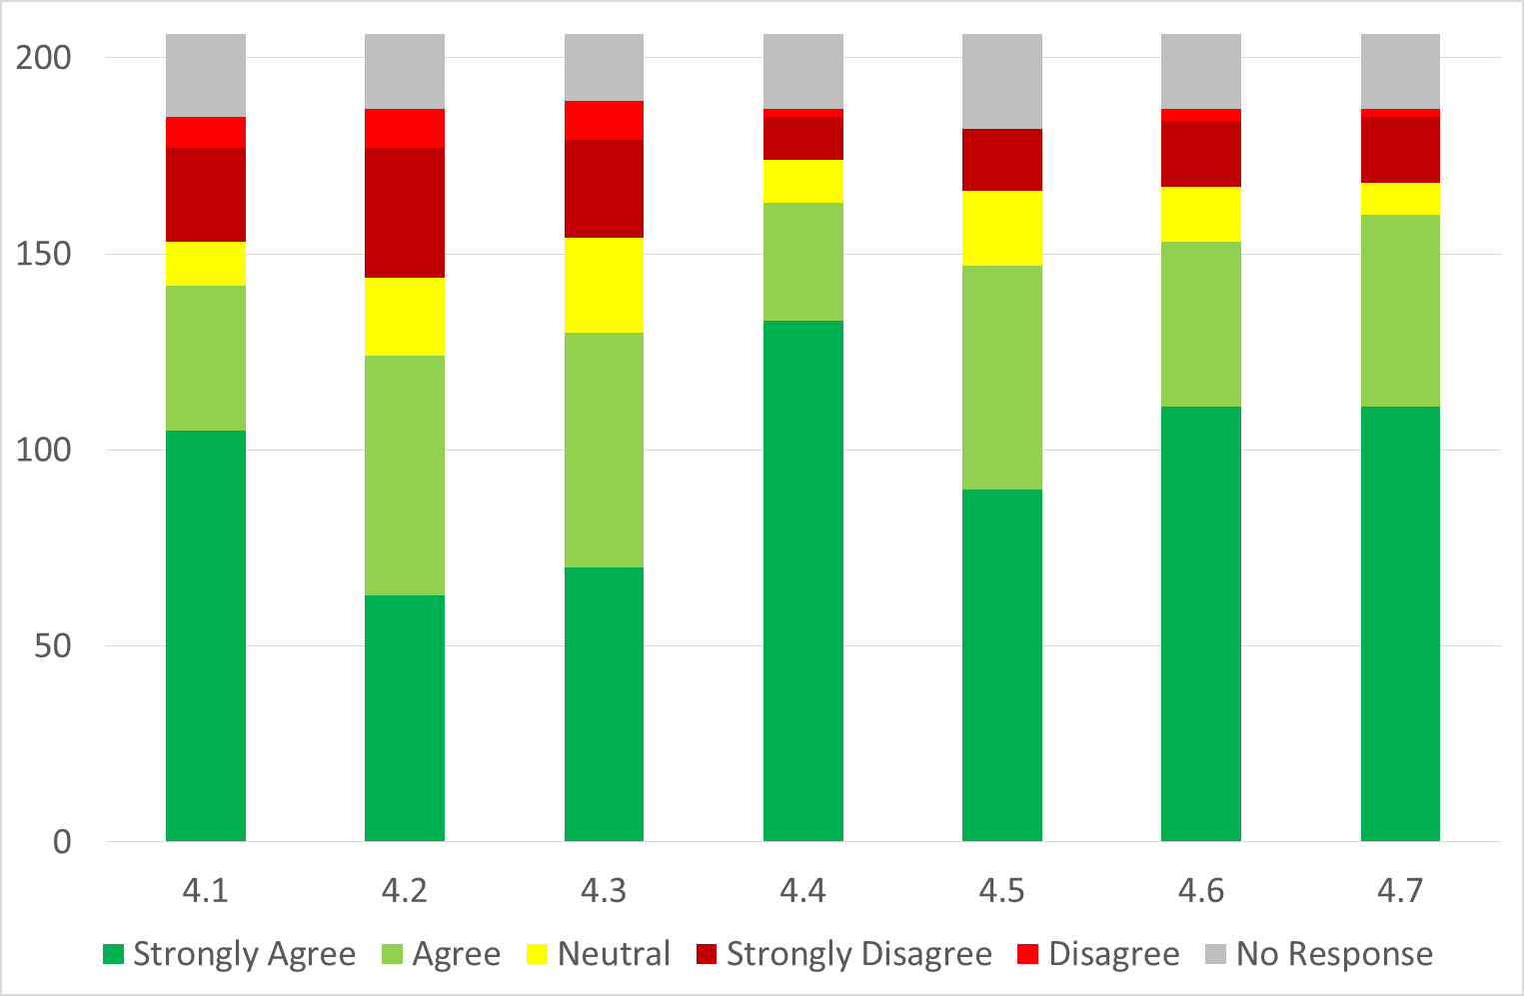
Objective 4: Deliver modest development that is sensitive to the environment, infrastructure constraints and improves the quality of life of all current and future residents

Slide 25
Objective 5: Maintain and improve local facilities for all residents
Engage with voluntary and community sectors to improve usage of existing facilities and identify areas for improving or adding to those facilities.
Understand the needs of young people and where funds allow extend facilities for them and ensure that their views are heard and addressed as far as possible.
Encourage members of the community to get involved in the activities of the Village.
Ensure any new housing/development identifies the impact on facilities and how the facilities can be enhanced to meet proposed growth. Where necessary, developers should also ensure that there is safe and easy access for residents from their site to local facilities and services.
Any new housing development must explore the economic viability of establishing community health facilities within the village.

Slide 26
Objective 5 – What’s important to you?
Maintain and improve local facilities for all residents - % of those responding agreeing or strongly agreeing
Ensure any development identifies the impact on facilities and how the facilities can be enhanced to meet proposed growth (84%)
Any new housing development must explore the economic viability of establishing community health facilities with in the village (65%)
Encourage members of the community to get involved in the activities in the village (77%)
Engage with voluntary & community sectors to improve usage of facilities (80%)
Understand that the needs of young people where funds allow to ensure their views are heard (81%)

Slide 27
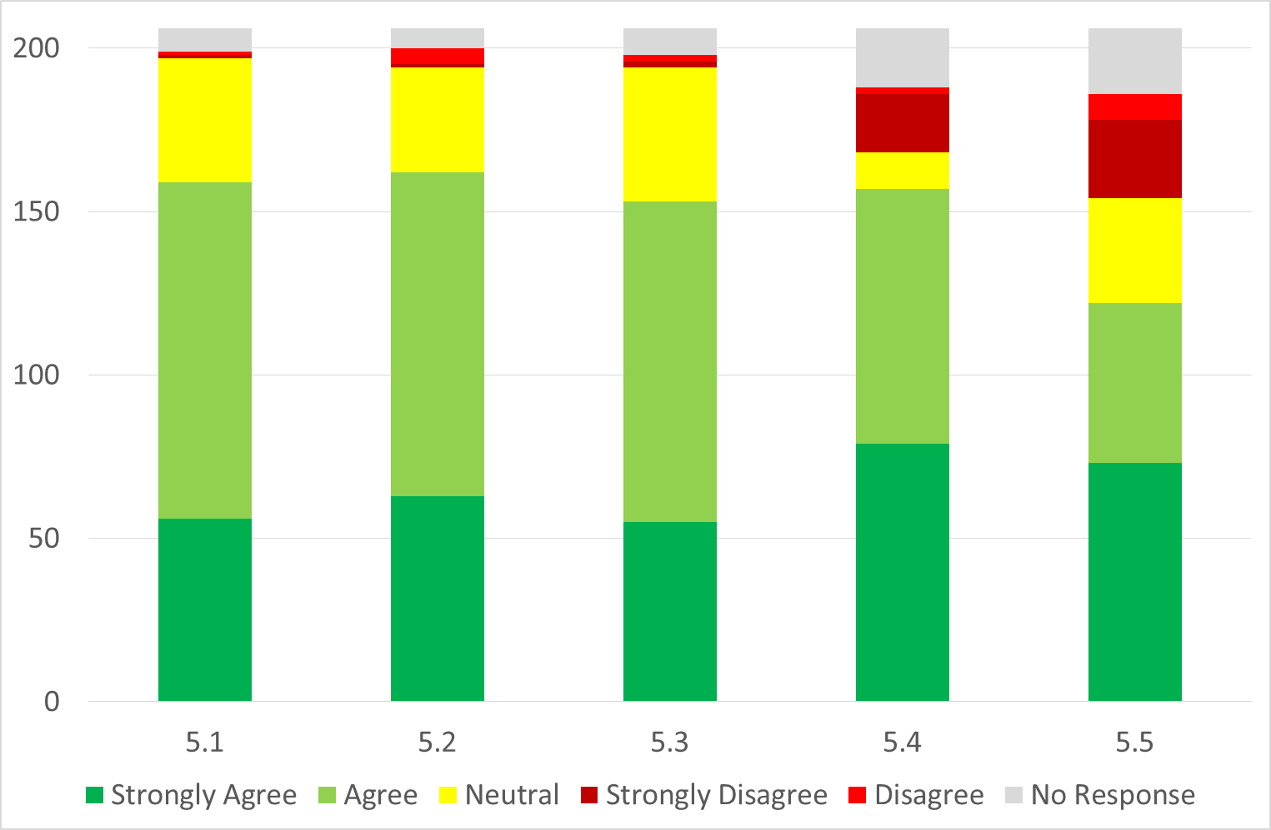
Objective 5: Maintain and improve local facilities for all residents

Slide 28
Summary
On the whole the majority of responses are in strongly favour of the proposed objectives/plans
Most 80% rating
Highest 90%+ - transport (safer routes for cyclists and pedestrians cross the ring road) and protecting green belt/open spaces
Lowest 60% - Security fencing around open areas

Slide 29
Next Steps
  Still work to be done to develop objectives into draft plan
  Liaise with CYC and residents
  Send Plan to CYC and Independent Examiner
  If they are content then hold referendum of local residents on Final Plan
  If then approved by 50%+1 of those voting, have a ‘made’ Plan which means planning and other decisions are based on policies specific to and tailored to the needs of Earswick

Slide 30
“Voting ‘no’ for a neighbourhood plan does not mean a vote for no development, but for no control over development”
Nicholas Boles MP
Planning Minister
2013

Slide 31
Introduction
The Draft Neighbourhood Plan will state that:
There will be no building on the green belt
There will be no change to the existing green belt boundary
Green spaces will be protected
Areas of conservation/wildlife value will be protected
Sports, Amenity and Leisure areas will be protected

Slide 32
Any Questions

